Slide 1
Two countries, twenty models and one secret weapon
CANCELLED!
Comparing change over time in convictions trajectories between Scotland and Queensland
Ben Matthews, University of Edinburgh | Edinburgh Q-step Seminar Series | 25th March 2019

Slide 2
Two countries, lots of models and one secret weapon
Two applications of the “many models” workflow
Ben Matthews, University of Edinburgh | Edinburgh Q-step Seminar Series | 25th March 2019

Slide 3
Overview
- The many models workflow
- Why do this to yourself?
- The secret weapon
- Change over time in criminal careers
- One latent class growth model per cohort
- Visualizing uncertainty
- How many latent classes?
- One latent class growth model per bootstrap
- What have we learned?

Slide 4
Not going to cover
How latent class growth models work
Too much detail on the data sources used
What the results mean substantively
Too much on how you would implement this workflow (but see example R code at https://github.com/benmatthewsed/qstep-march-2019)

Slide 5
Many models

Slide 6

Many models
Use many simple models to better understand complex datasets.
Use list-columns to store arbitrary data structures in a data frame.
Turn models into tidy data so you can work with model results like any other dataset.
https://r4ds.had.co.nz/many-models.html

Slide 7
List-columns?
“Arbitrary data” can include, well anything!
A dataset, a model call, model results…
# A tibble: 18 x 4
birth_year data mplus_command k_2
<int> <list> <list> <list>
1 1973 <tibble [1,114 x 12]> <S3: mplusObject> <S3: mplusObject>
2 1974 <tibble [1,102 x 12]> <S3: mplusObject> <S3: mplusObject>
3 1975 <tibble [1,072 x 12]> <S3: mplusObject> <S3: mplusObject>
...
18 1990 <tibble [770 x 12]> <S3: mplusObject> <S3: mplusObject>

Slide 8
List-columns and iteration
For each one of a group of things do some thing to them
For each birth year, fit a two class model to that cohort’s data using the appropriate Mplus command
# A tibble: 18 x 4
birth_year data mplus_command k_2
<int> <list> <list> <list>
1 1973 <tibble [1,114 x 12]> <S3: mplusObject> <S3: mplusObject>
2 1974 <tibble [1,102 x 12]> <S3: mplusObject> <S3: mplusObject>
3 1975 <tibble [1,072 x 12]> <S3: mplusObject> <S3: mplusObject>
...
18 1990 <tibble [770 x 12]> <S3: mplusObject> <S3: mplusObject>

Slide 9

Iteration in R
I used R’s purrr package to iterate (there are other ways too)
Lots of great resources to learn about iteration using purrr:
https://github.com/cwickham/purrr-tutorial/blob/master/slides.pdf
https://speakerdeck.com/jennybc/purrr-workshop
https://github.com/jenniferthompson/RLadiesIntroToPurrr

Slide 10
Why do this to yourself?

Slide 11
“The Secret Weapon”

Slide 12
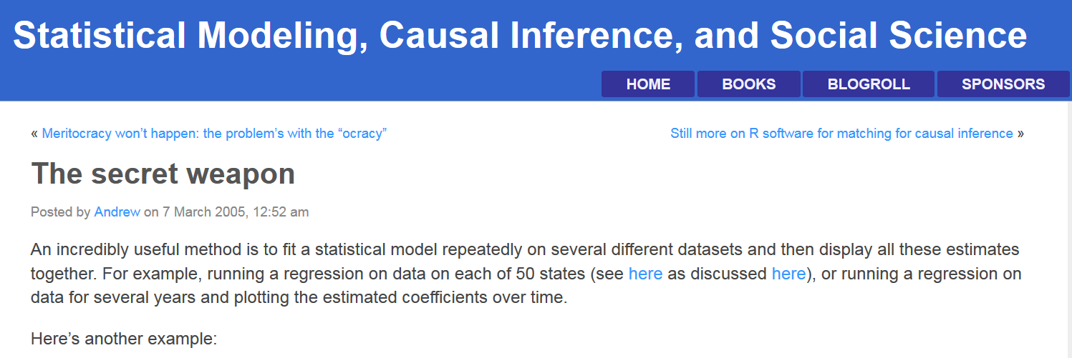
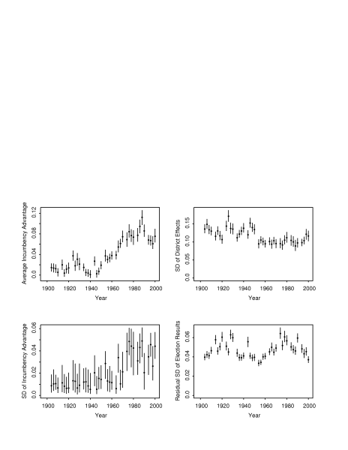
https://statmodeling.stat.columbia.edu/2005/03/07/the_secret_weap/

Slide 13
Changing Criminal Careers
Well-established relationship between age and crime as far back as Quetelet in 1831
Significant change in last 25 or so years in Scotland (Matthews and Minton 2018)
Fit a model to successive cohorts in the Scottish Offenders Index and compare results!

Slide 14
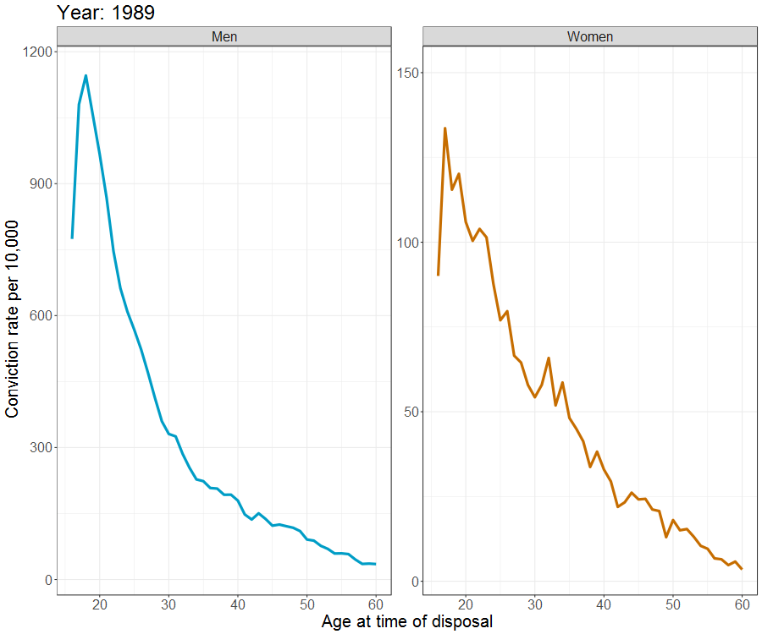

Slide 15
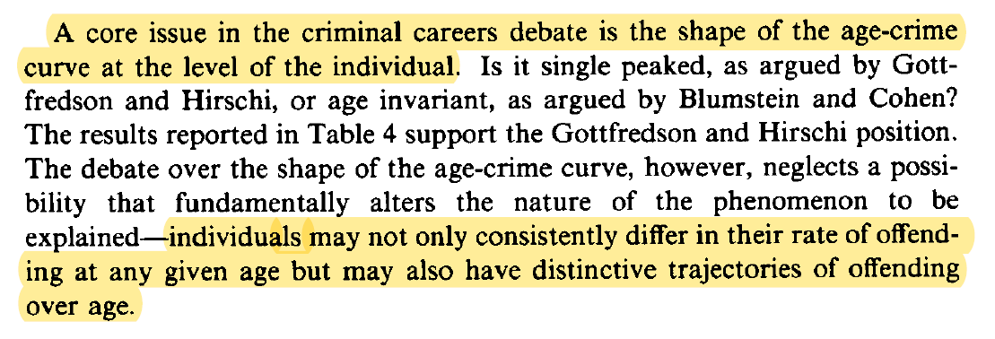
Nagin and Land (1993:346) Age, Criminal Careers, and Population Heterogeneity: Specification and Estimation of a Nonparametric, Mixed Poisson Model, Criminology, Vol. 31, No. 3, pp. 327:362

Slide 16
Identifying conviction trajectories
Latent Class Growth Mixture Model (LCGM, Nagin and Land 1993), makes groups out of data based on a repeated measures dependent variable
Each group gets a trajectory (in our case, probability of conviction in a given year)
LCGMs are very popular (if divisive) in criminology (Nagin and Land 2005a, 2005b; Sampson and Laub 2005)

Slide 17
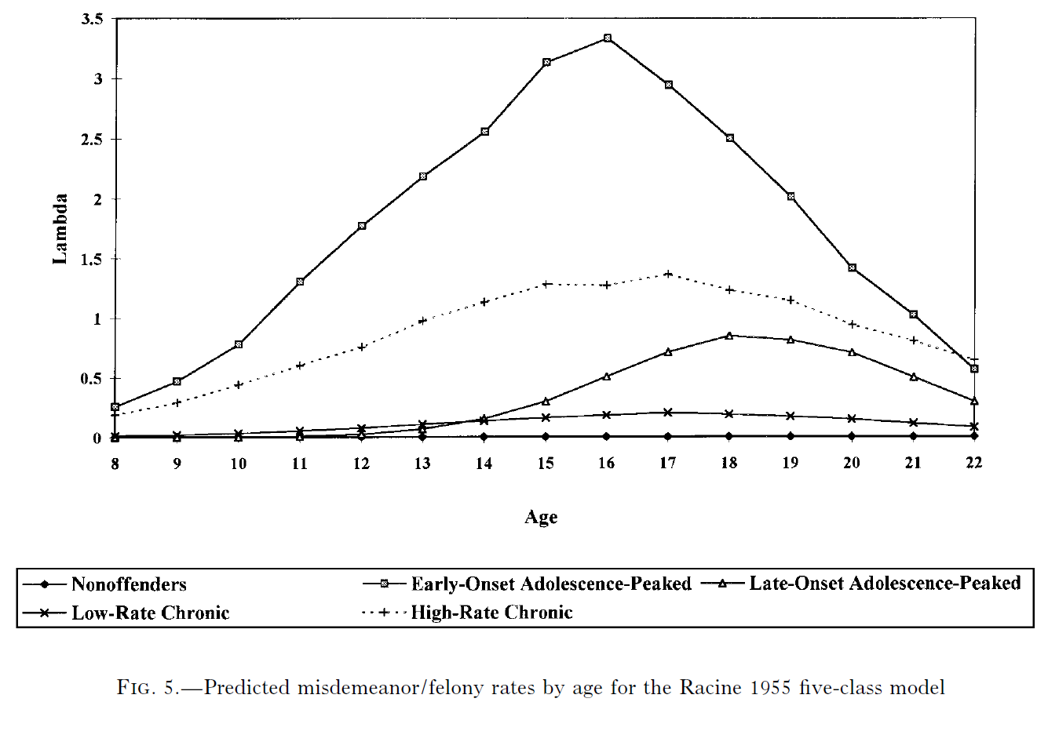
D’Unger et al. (1998), How Many Latent Classes of Delinquent/Criminal Careers? Results from Mixed Poisson Regression Analyses, American Journal of Sociology, Vol. 103, No. 6, pp. 1593-1630

Slide 18
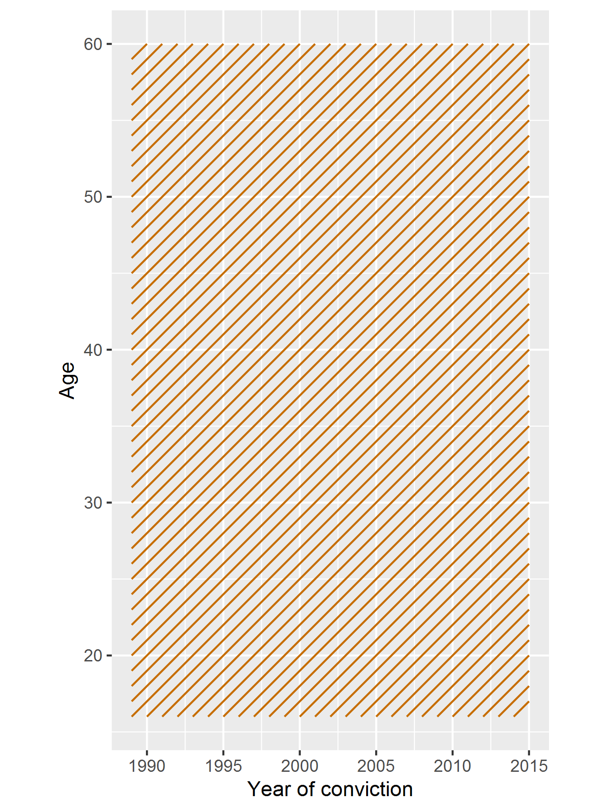
Many LCGMs
For each cohort,
fit LCGM

Slide 19
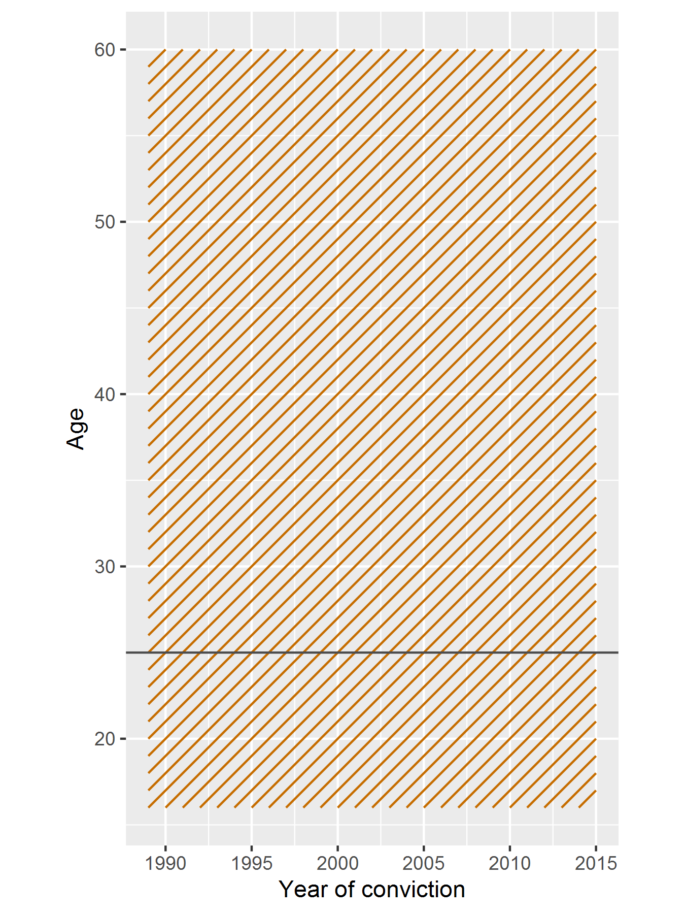
Many LCGMs
For each cohort,
fit LCGM

Slide 20
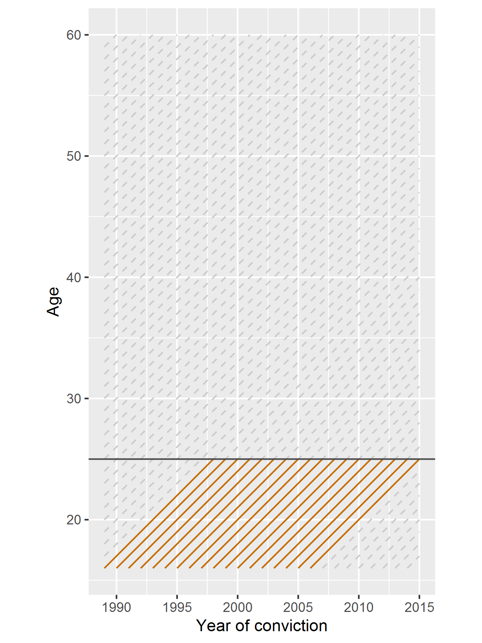
Many LCGMs
For each cohort,
fit LCGM

Slide 21
Modelling strategy
Models fit in Mplus 8.2 using the MplusAutomation (Hallquist and Wiley 2018) R package to call Mplus, fit the models and then pull the results back into R
This lets you use R’s standard iteration tools with Mplus
Results here from a subset of data from Scottish Offenders Index

Slide 22
Parameters of interest
Shape of trajectories
Number of classes in “best” model
Proportion of people assigned to each class

Slide 23
How many latent classes?
- Model selection process:
AIC/BIC/aBIC
(VLMR test)
(BLRT test)
Substantive interpretation
Norris method (see Norris, 2009)
More art than science?
Tricky enough with one model!

Slide 24
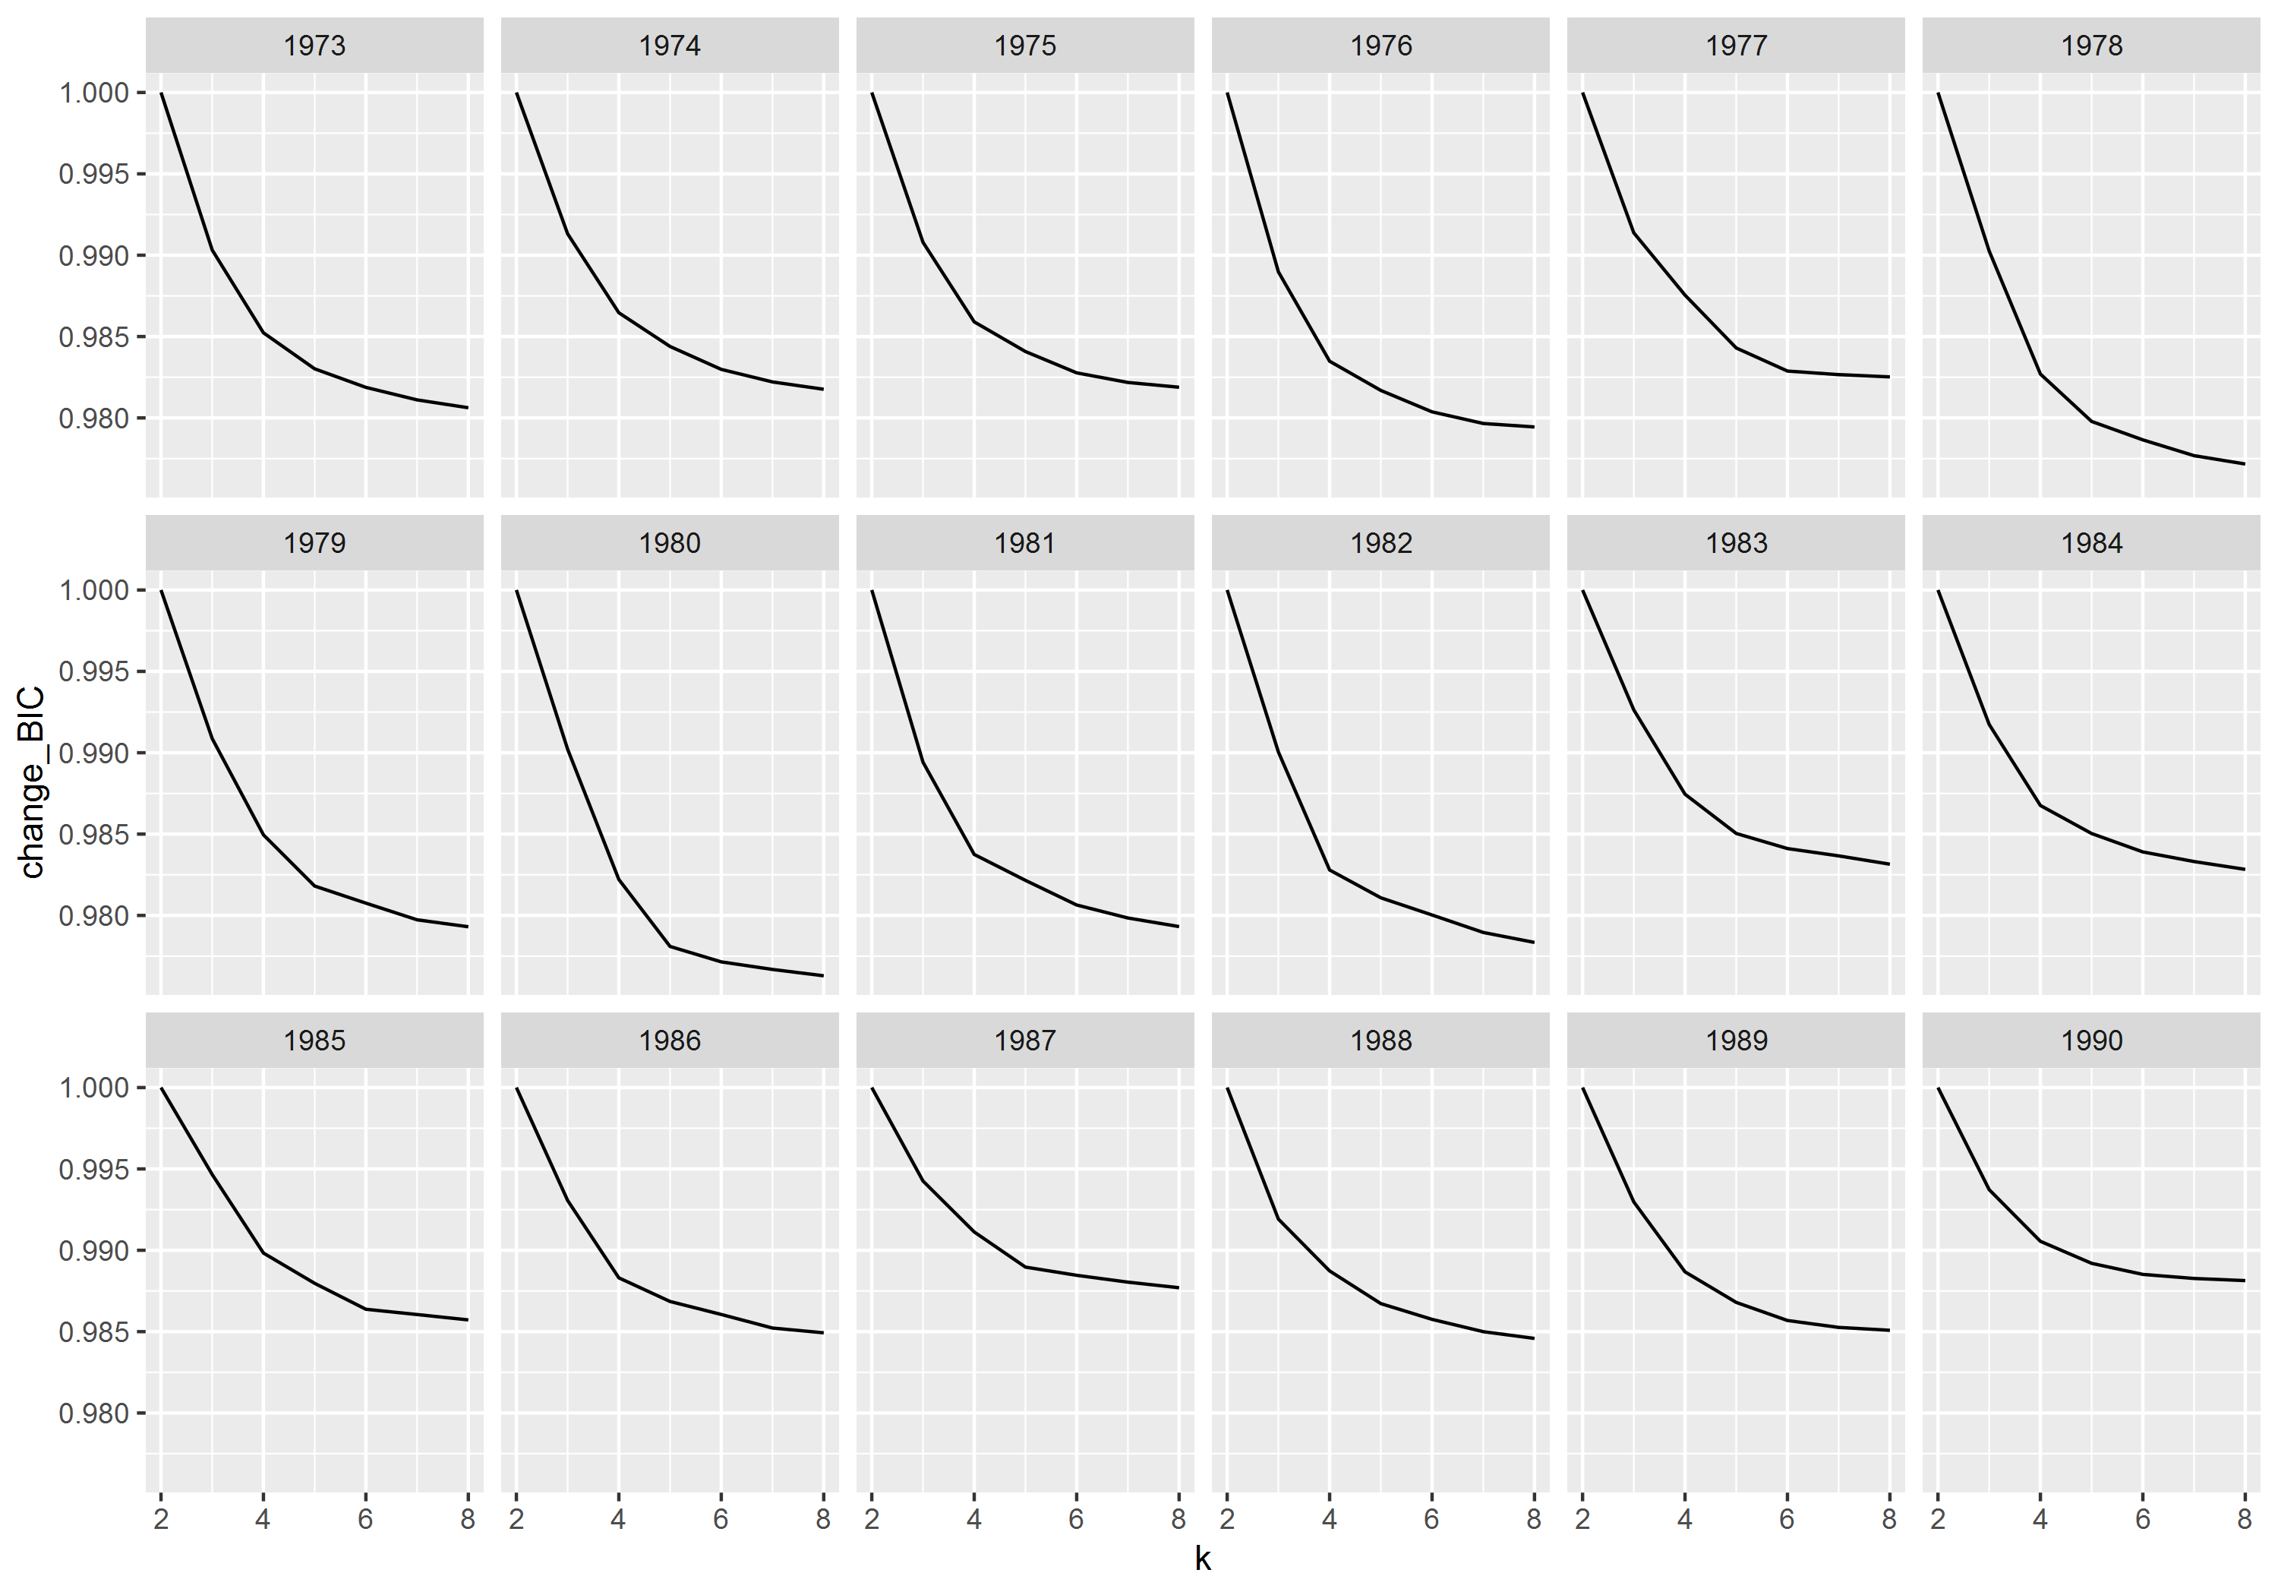
Note: Analysis does not include the full SOI dataset and so should not be interpreted substantively

Slide 25
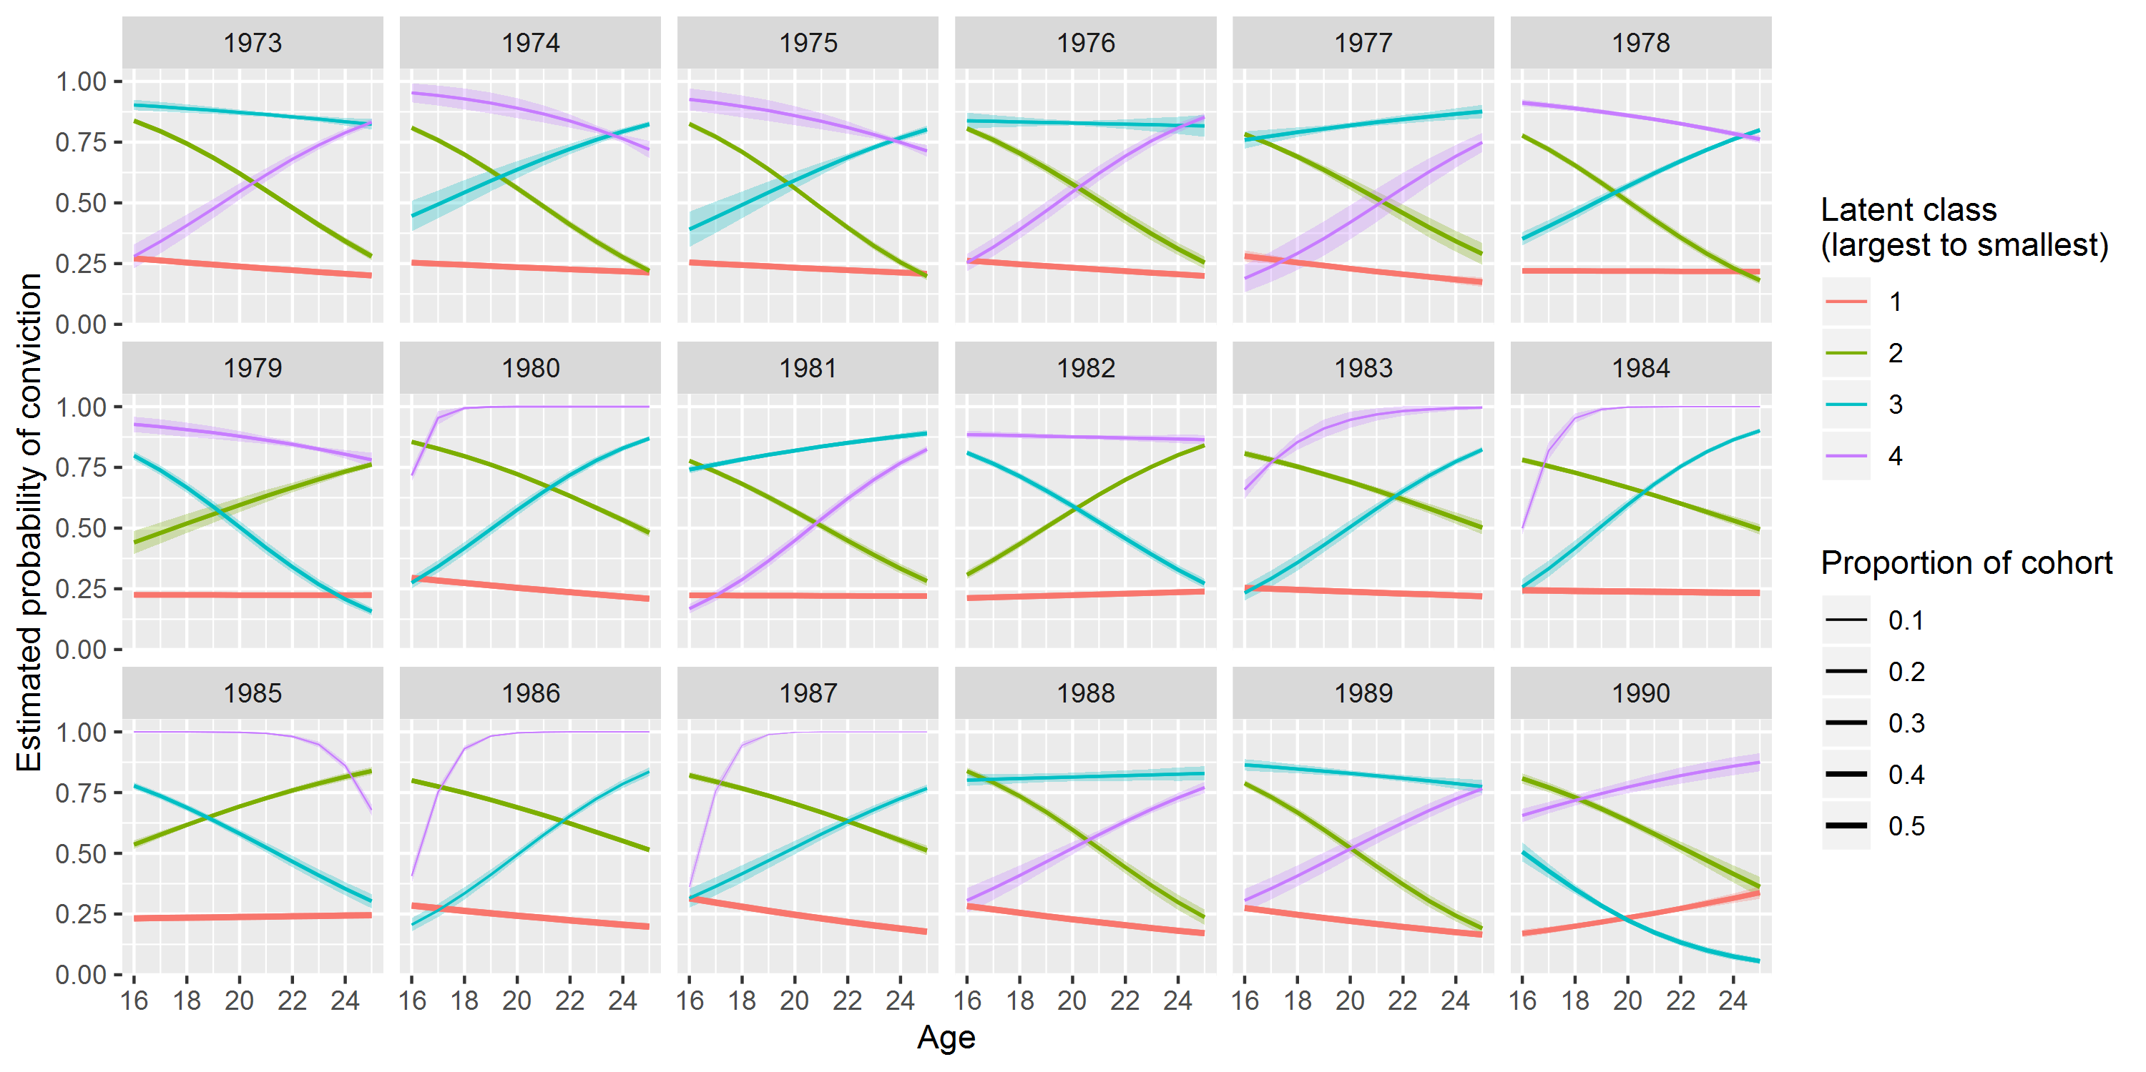
Note: Analysis does not include the full SOI dataset and so should not be interpreted substantively

Slide 26
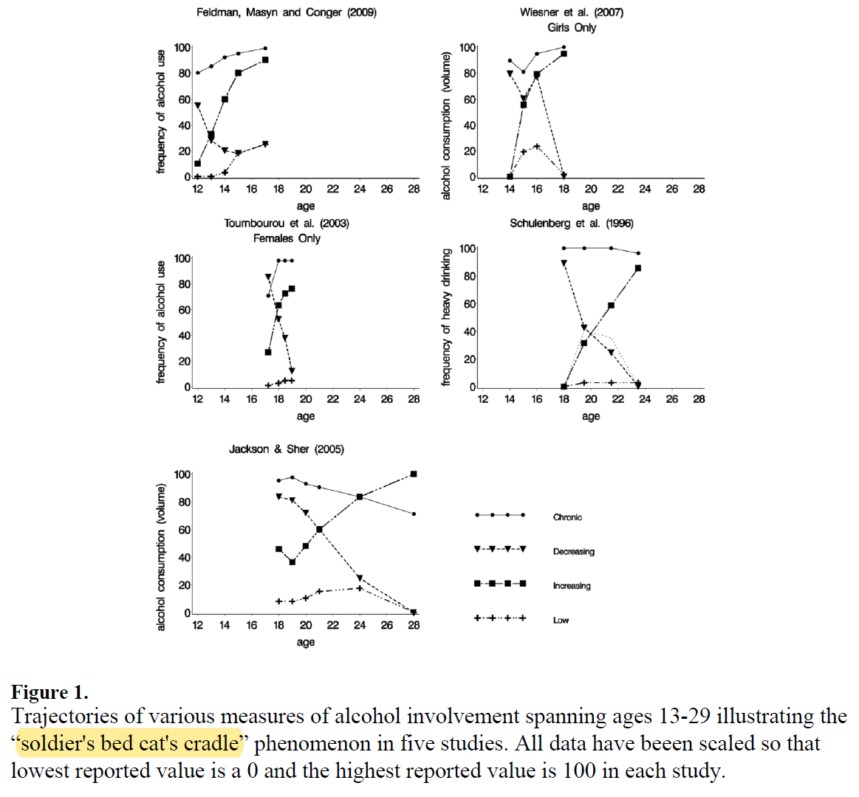
Sher et al. (2011), Alcohol Use Trajectories and the Ubiquitous Cat's Cradle: Cause for Concern?, J Abnorm Psychol, Vol. 120, No. 2, pp. 322-335

Slide 27
Results
Does look like there’s some differences between cohorts in the trajectory shapes, but cat’s cradle means it’s hard to tell
… but are these differences meaningful? Many models approach means we don’t know statistically
One model per cohort means class definitions change – can’t really compare proportion assigned
Are there different number of classes across cohorts? Selection is very subjective!

Slide 28
Visualizing uncertainty in LCGMs
“Point estimates should be accompanied by information on precision!!!”
- Vernon Gayle

Slide 29
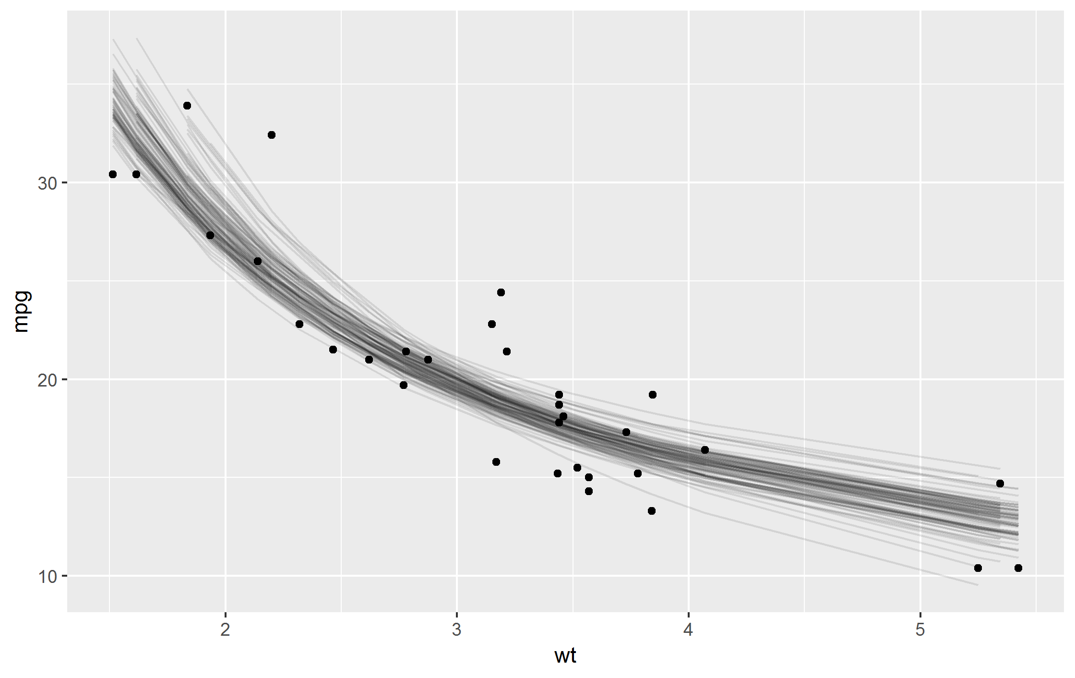
Motivation 1: Lots of lines!
https://cran.r-project.org/web/packages/broom/vignettes/bootstrapping.html

Slide 30
Motivation 2: What do these latent groups mean?
Direct (LCGM groups are real!) and indirect interpretations (LCGM groups are statistical shorthand!) (Bauer 2007:779)
In some cases, aetiology of groups is theorized after they have been identified by LCGM (Krohn et al. 2013:194)
Are we just chasing noise?

Slide 31


Many LCGMs (again)
Sample with replacement 25 times from original dataset using rsample package
For each bootstrap replication, fit LCGM
Work with bootstrap replications as with any (nested/list-column) dataset
See Carsey and Harden (2014) on bootstrapping methods

Slide 32
Many LCGMs (again)
Data from Racine, Wisonsin 1955 birth cohort (downloaded from https://www.icpsr.umich.edu/icpsrweb/)
Remember: substantive interest in the shape of the different trajectories, art of model selection
Not going to discuss substantive meaning of these trajectories

Slide 33
How many latent classes?
Model selection process:
AIC/BIC/aBIC
(VLMR test)
(BLRT test)
Substantive interpretation
“Norris method” (see Norris, 2009)
... Consistency of trajectory shapes across bootstrap replications?

Slide 34
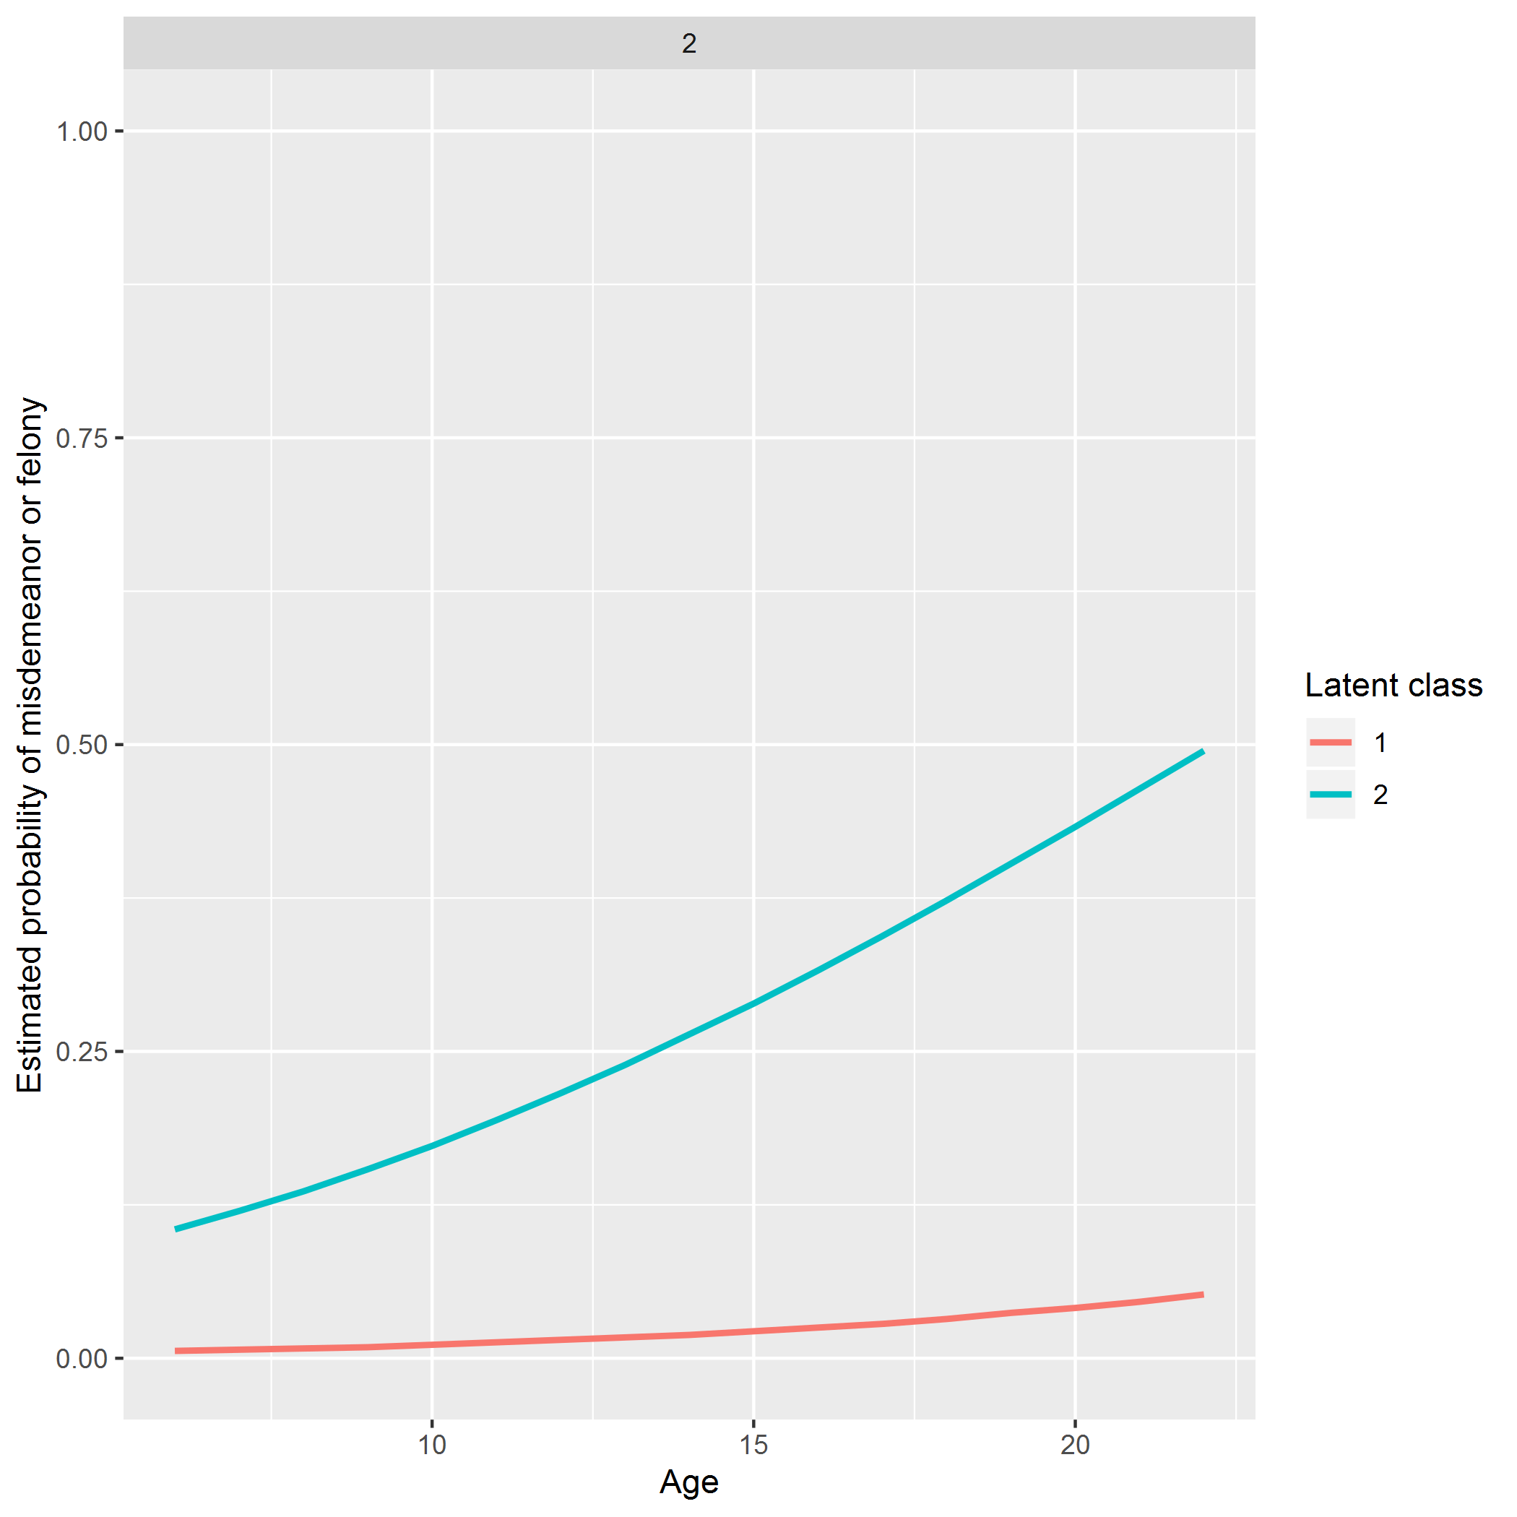

Slide 35
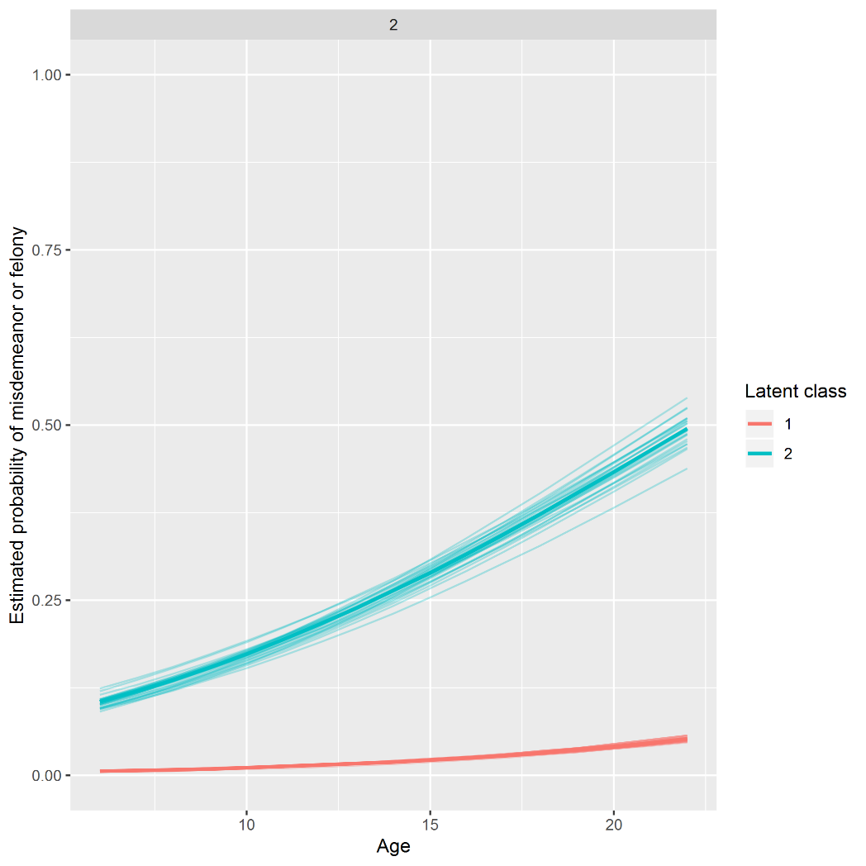


Slide 36
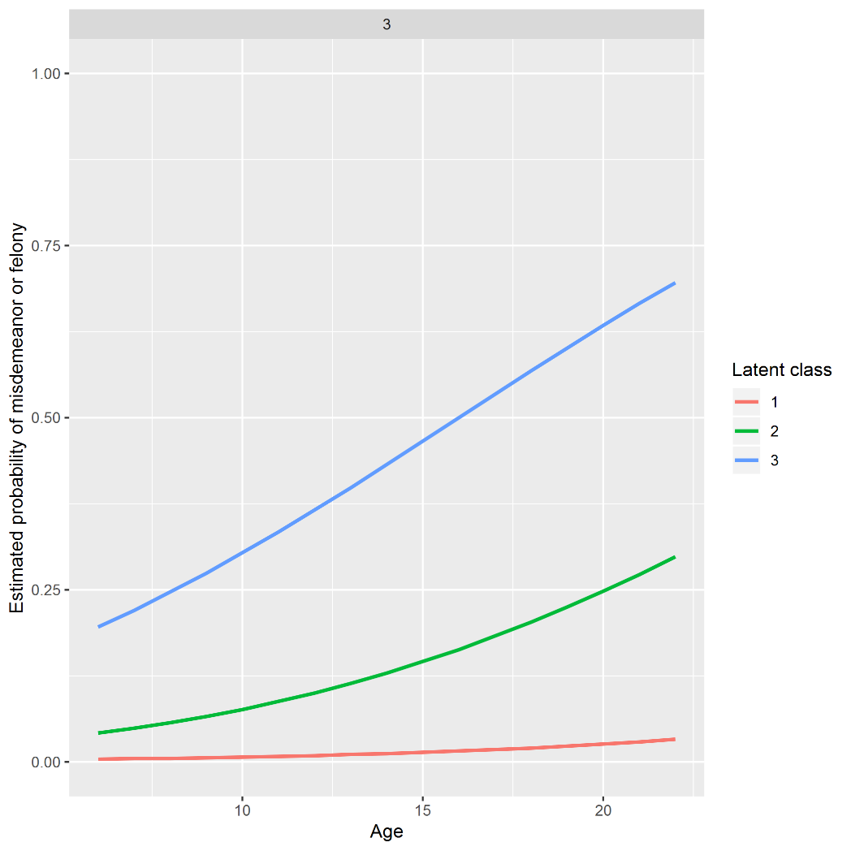

Slide 37
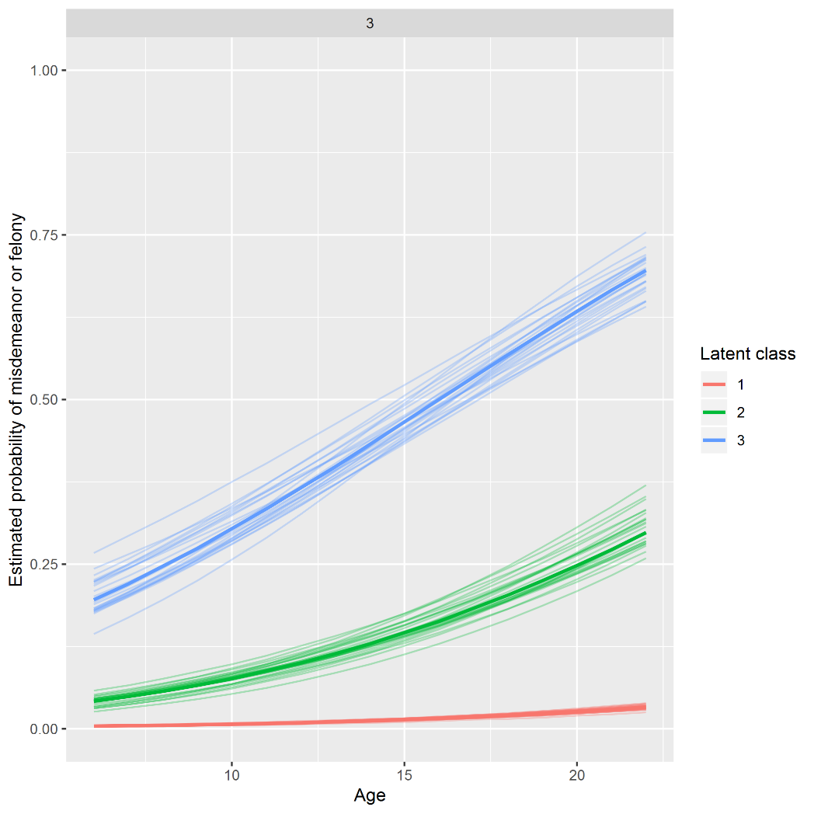


Slide 38
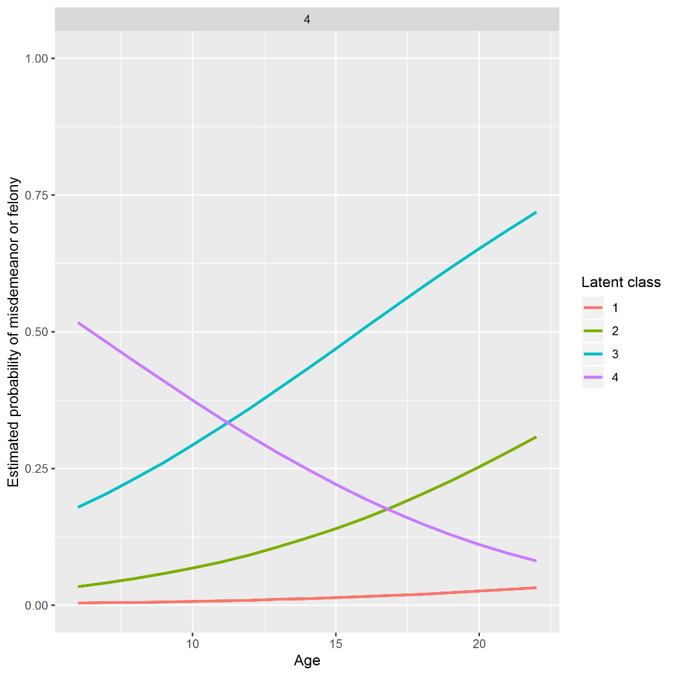

Slide 39
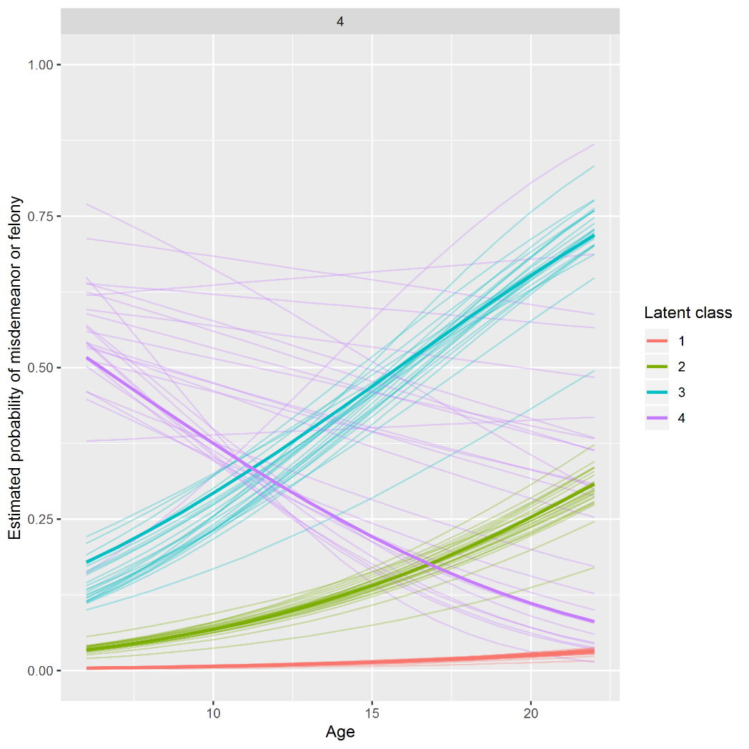


Slide 40
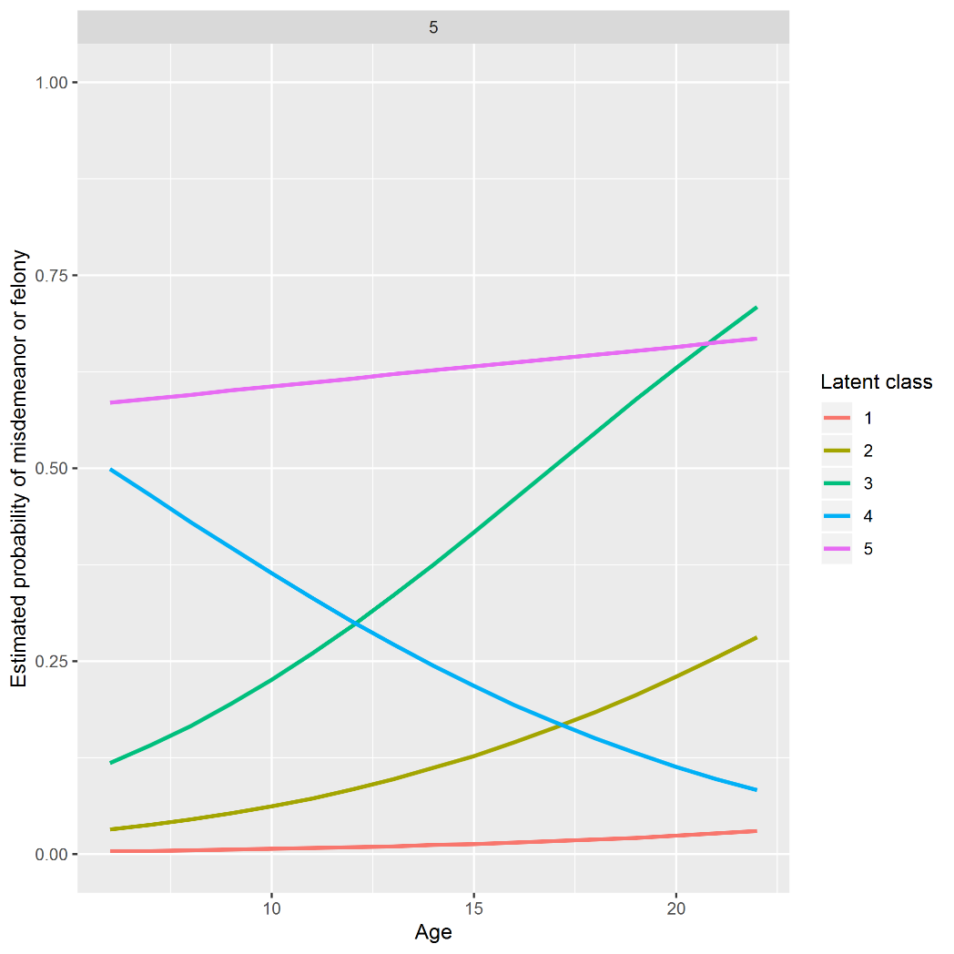

Slide 41
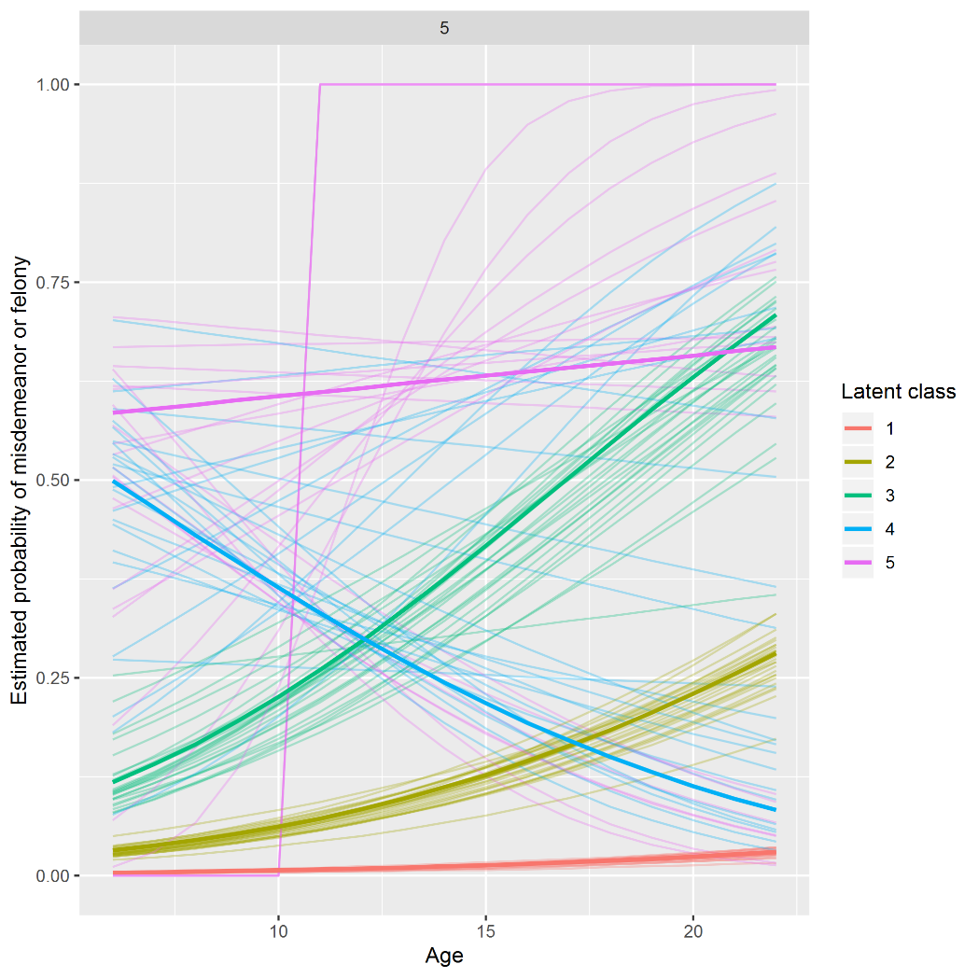


Slide 42
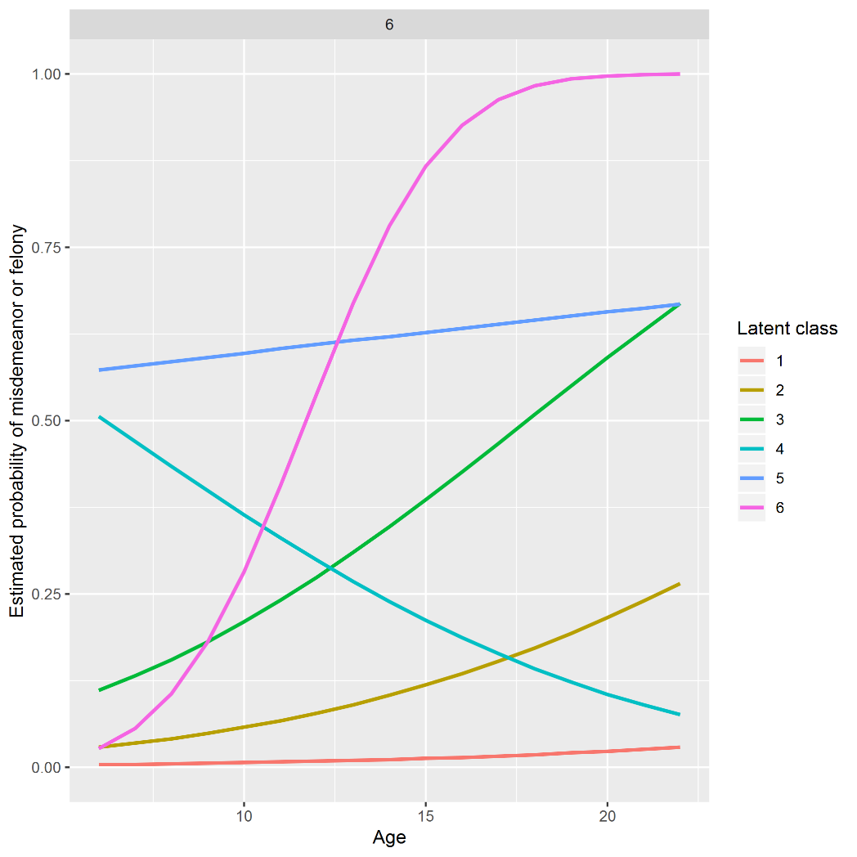

Slide 43
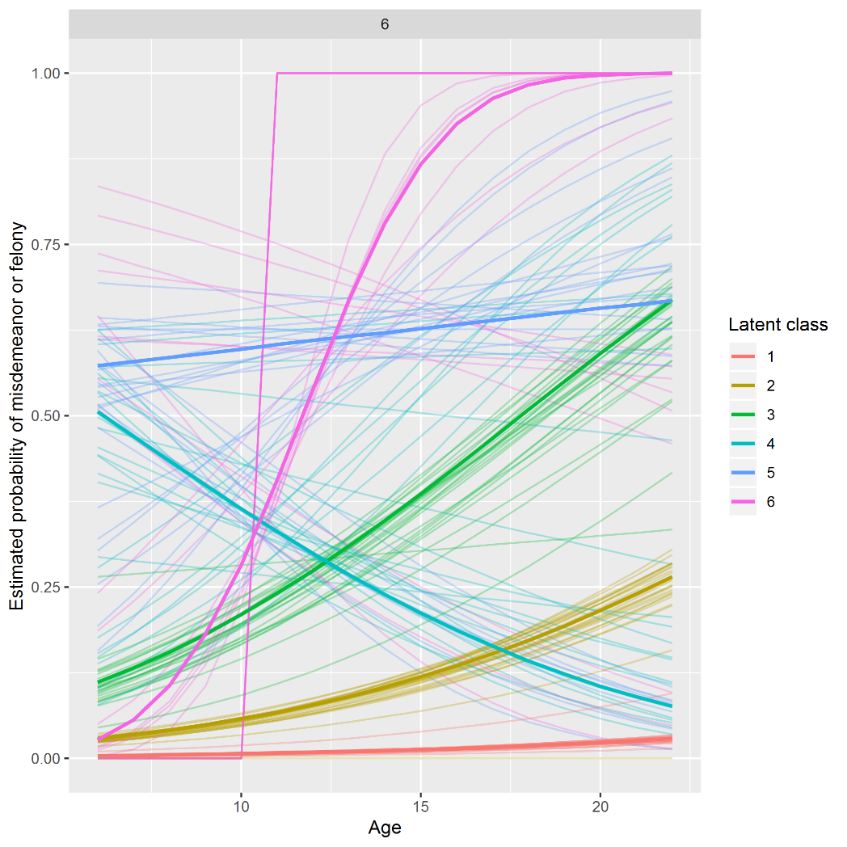


Slide 44
Results
These figures would suggest maybe a three or possibly a four-class model?
Trajectory shapes from five- and six-class models aren’t stable across replications
… But is it appropriate to move from bootstrapping to visualizing uncertainty to model selection?

Slide 45
What have we learned?

Slide 46
Summary
Many models workflow has positives and negatives
Not so sure the ‘secret weapon’ was useful for me
It was useful for re-fitting models to bootstrap replications to see what the LCGM was doing

Slide 47
Questions for you
Is this a useful approach to look at change over time in the LCGMs?
Is bootstrapping to select number of classes a valuable technique?
If so, how many bootstrap replications do you need?
For hypothetical outcome plots (Hullman et al. 2015) ~20
To calculate CIs usually 999 or 1999 (Carsey and Harden 2014)
Limitation – time and processing power!

Slide 48
Thank you!
@benmatthewsed | ben.matthews@ed.ac.uk
These slides and bootstrapping code at: https://github.com/benmatthewsed/qstep-march-2019
-
Thanks to Scottish Government for providing SOI data and Amy Tilbrook, Suhail Iqbal and Dave Stobie at ADRC-Scotland for facilitating data access

Slide 49
References (not elsewhere cited)
Bauer, D. J. (2007). Observations on the Use of Growth Mixture Models in Psychological Research. Multivariate Behavioral Research, 42(4), 757–786.
Carsey, T. M., & Harden, J. J. (2013). Monte Carlo simulation and resampling methods for social science. Sage Publications.
Hallquist, M. N., & Wiley, J. F. (2018). MplusAutomation: An R Package for Facilitating Large-Scale Latent Variable Analyses in Mplus. Structural equation modeling: a multidisciplinary journal, 25(4), 621-638.
Hullman, J., Resnick, P., & Adar, E. (2015). Hypothetical outcome plots outperform error bars and violin plots for inferences about reliability of variable ordering. PloS one, 10(11)
Krohn, M. D., Gibson, C. L., Thornberry, T. P. (2013). Under the protective bud the bloom awaits: A review of theory and research on adult-onset and late-blooming offenders. In Gibson, C., Krohn, M. D. (Eds.), Handbook of life-course criminology (pp. 183-200). New York, NY: Springer.
Matthews, B., & Minton, J. (2018). Rethinking one of criminology’s ‘brute facts’: The age–crime curve and the crime drop in Scotland. European journal of criminology, 15(3), 296-320.
Norris, P. (2009). Policing priorities in London: do borough characteristics make a difference?. PhD thesis, University of Edinburgh.
Quetelet, A. (1831/2003). Research on the Propensity for Crime at Different Ages, translated by S.F. Sylveski. In P. Bean (Ed.), Crime: Critical Concepts in Sociology (pp. 119–135). London: Taylor & Francis.
Wickham, H., & Grolemund, G. (2016). R for data science: import, tidy, transform, visualize, and model data. O'Reilly Media, Inc.

